Slide 1
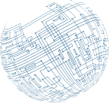



Physical
Security Controls

Slide 2
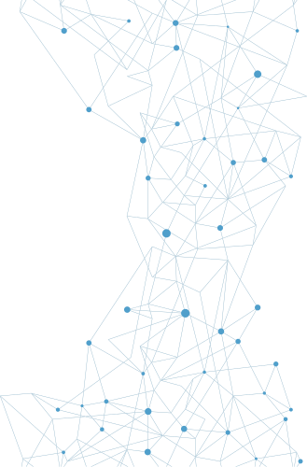
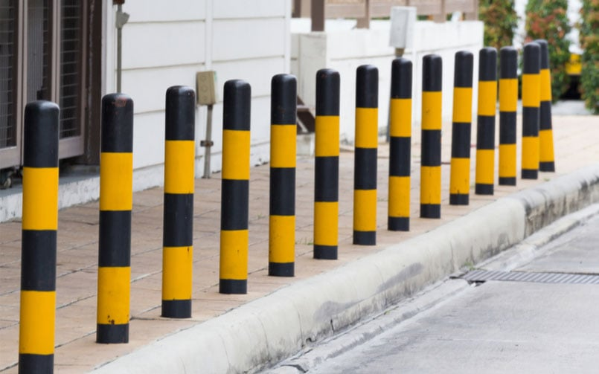
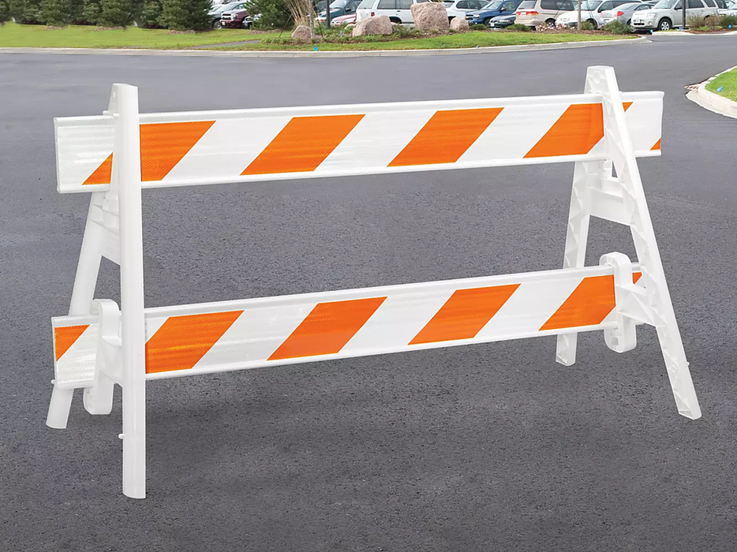
Bollards
and Barricades
The primary defense against a majority of physical attacks is the barricades between the assets and a potential attacker—walls, fences, gates, and doors. Barricades provide the foundation upon which all other security initiatives are based, but the security must be designed carefully, as an attacker has to find only a single gap to gain access.
Barricades can also be used to control vehicular access to and near a building or structure. The simple post-type barricade that prevents a vehicle from passing but allows people to walk past is called a bollard.

Slide 3
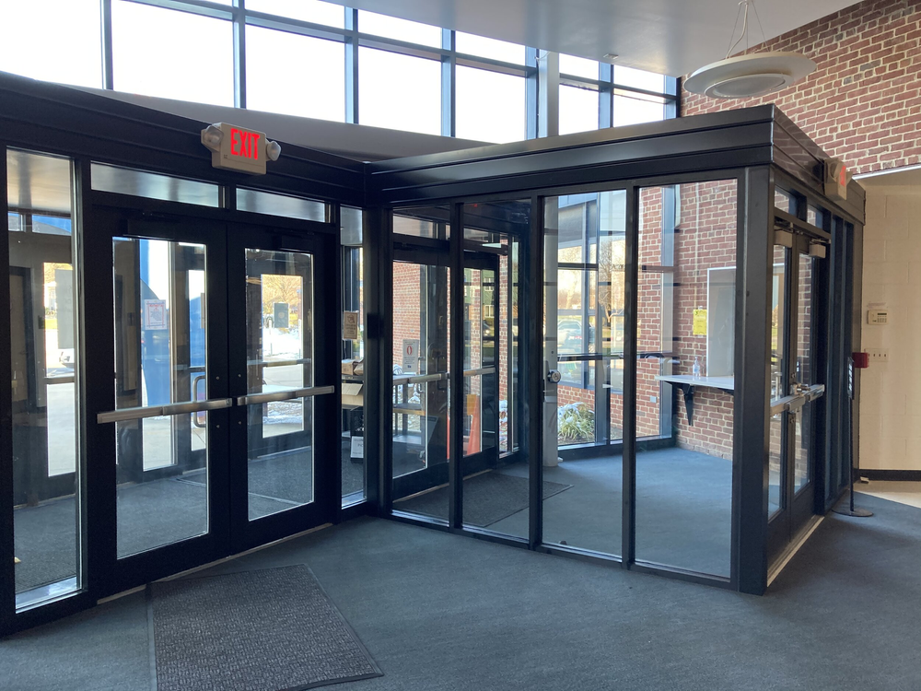
Access
Control Vestibule
The implementation of a access control vestibule, also called a mantrap, is one way to combat tailgating. An access control vestibule is composed of two closely spaced doors that require the user to card through one and then the other sequentially. Mantraps make it nearly impossible to trail through a doorway undetected—if an intruder happens to catch the first door before it closes, he will be trapped in by the second door, as the second door remains locked until the first one closes and locks.

Slide 4
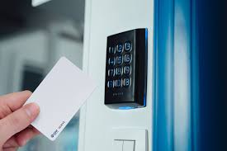
Badges
A badge with a picture on it can enable others to quickly determine if you are an employee or not. Visitors are given their own badge that identifies them as a visitor. Radio-frequency identification (RFID) uses electromagnetic fields to automatically identify and record information. RFID tags are widely used in identification badges, replacing earlier magnetic stripe cards and making them useable with just a swipe near a reader.

Slide 5

Alarms
Alarms serve to alert operators to abnormal conditions. Physical security can involve numerous sensors, intrusion alarms, motion detectors, switches that alert to doors being opened, video and audio surveillance, and more. Each of these systems can gather useful information, but it is only truly useful if it is acted upon. When one of these systems has information that can be of use to operational personnel, an alarm is the easiest method of alerting personnel to the condition.

Slide 6
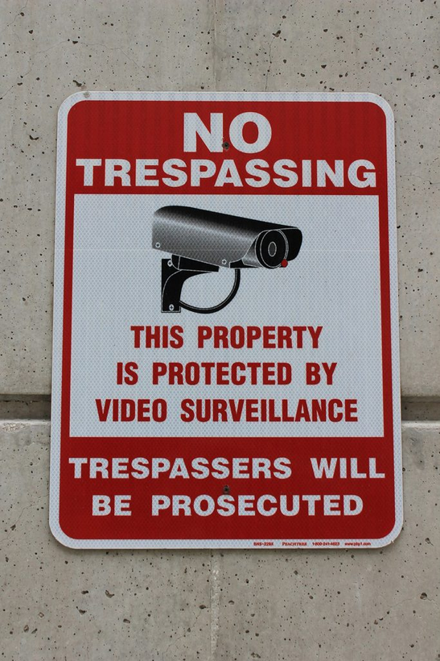
Signage
Signage can provide information as to areas that are restricted, or it can indicate where specific precautions, such as keeping doors locked, are required. A common use of signs in high-security facilities is to delineate where visitors are allowed versus secured areas where escorts are required. Visual security clues can assist in alerting users to the need for specific security precautions.

Slide 7
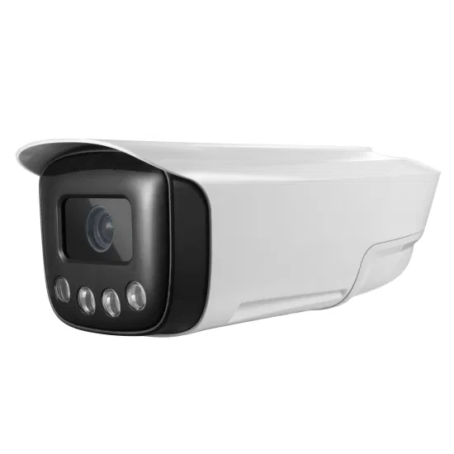
Cameras
From recording evidence for later use, like taking pictures of equipment, serial number panels, and so on, to collecting evidence at crime scenes, cameras enable the re-creation of scenes at a later date.

Slide 8
Cameras
MOTION RECOGNITION
Motion recognition is an important technology to limit the search time and recording space associated with video images. Infrared (IR) radiation is not visible to the human eye, but it can be used just like a light source to detect a range of things. Motion from living creatures can be seen because of the heat signatures of their bodies. Infrared detection is a technical means of looking for things that otherwise may not be noticed.

Slide 9
Cameras
OBJECT DETECTION
Modern surveillance video systems come with some impressive software. Even cameras sold to homeowners can scan video for movement and detect people, cars, and other designated objects such as packages left on a porch. The use of video software for object detection does not replace the human eye, but it significantly enhances a guard’s ability to effectively use large banks of cameras to cover a facility. The citywide video surveillance system in London was the primary source of evidence that identified the terrorists who set off a series of bombs across the city in 2005

Slide 10
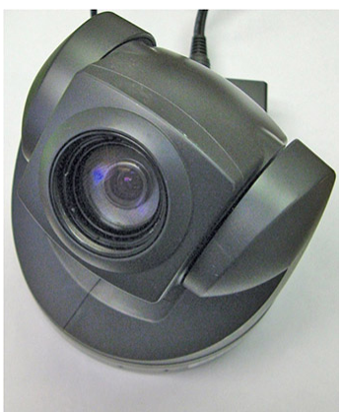
CCTVs
Video surveillance is typically done through closed-circuit television (CCTV). The use of CCTV cameras for surveillance purposes dates back to at least 1961, when cameras were installed in the London Transport train station. The development of smaller camera components and lower costs has caused a boon in the CCTV industry since then

Slide 11
Industrial
Camouflage
Camouflage is the specific act of rendering an item not readily observable. Considered by many to be a military thing, camouflage began in nature, where insects and animals have patterns making them seem to be different than they really are. This same principle is used all the time to make things hide in plain sight. Cell phone towers built to look like trees make them less conspicuous—and generally improve the visual surroundings. In response to physical acts against electrical substations, many utilities have put walls around the substations, making the internal equipment no longer visible and less of a target.

Slide 12
Personnel
GUARDS
Security guards provide an excellent security measure, because guards are a visible presence with direct responsibility for security. Other employees expect security guards to behave a certain way with regard to securing the facility. Guards typically monitor entrances and exits and can maintain access logs of who has entered and departed the building. In many organizations, everyone who passes through security as a visitor must sign a log, which can be useful in tracing who was at what location and why.

Slide 13
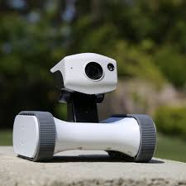
Personnel
ROBOT SENTRIES
Robot sentries can patrol empty buildings and using sensors can detect the presence of unauthorized people. Robot sentries can then report the issue to a manned station that can alert the proper authorities for a response.

Slide 14
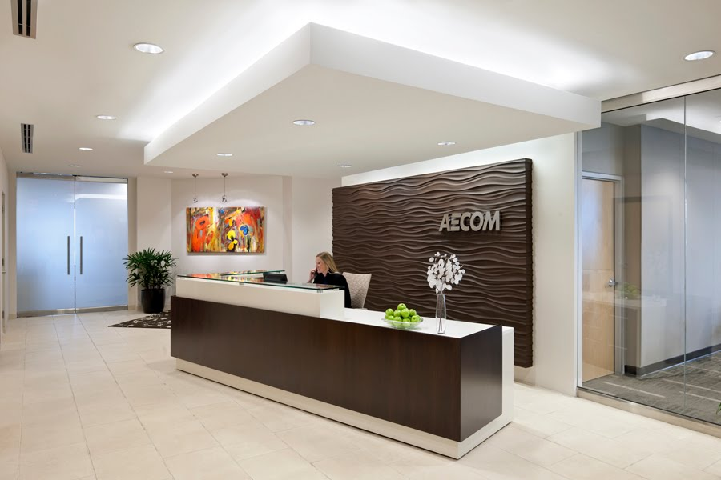
Personnel
RECEPTION
Robot sentries can patrol empty buildings and using sensors can detect the presence of unauthorized people. Robot sentries can then report the issue to a manned station that can alert the proper authorities for a response.

Slide 15
Personnel
TWO-PERSON INTEGRITY/CONTROL
Two-person integrity/control is this principle in action: it is when two different people have to perform respective tasks that are both necessary for the action to occur. Person 1 can initiate a process, check IDs, enter data in a log, and issue a visitor badge, while person 2 can control the door access. This way, a failure by either person does not expose the process.

Slide 16
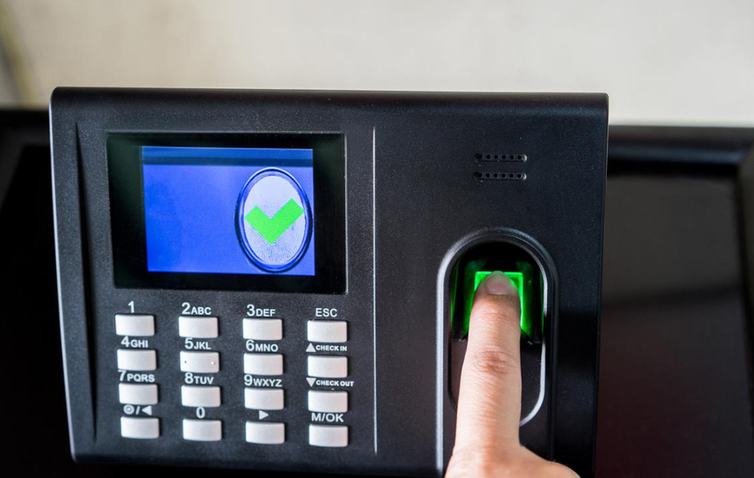
Locks
BIOMETRICS
Biometrics is the measurement of biological attributes or processes with the goal of identification of a party possessing those measurements. The most well-known biometric factor is the fingerprint. Fingerprint readers have been available for several years in laptops and other mobile devices,

Slide 17
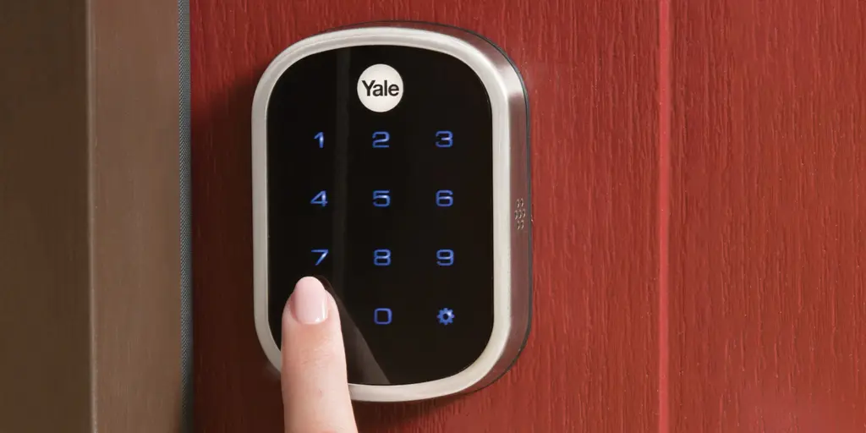
Locks
ELECTRONIC LOCKS
Electronic locks are devices that impede a specific function unless a code is entered. This code is compared to a stored secret, and if the correct code is entered, the lock engages the mechanical stop and allows the mechanism to open. Electronic locks have an advantage in that they are not as susceptible to mechanical manipulation and bypass, yet they are still susceptible, in many cases via the mechanism that updates the secret “combination.”

Slide 18
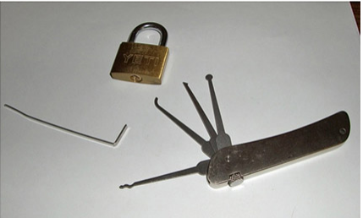
Locks
PHYSICAL LOCKS
Physical locks have been used for hundreds of years; their design has not changed much: a metal “token” is used to align pins in a mechanical device. Physical locks have survived for years because they are low cost. Because all mechanical devices have tolerances, it is possible to sneak through these tolerances by “picking” the lock.

Slide 19
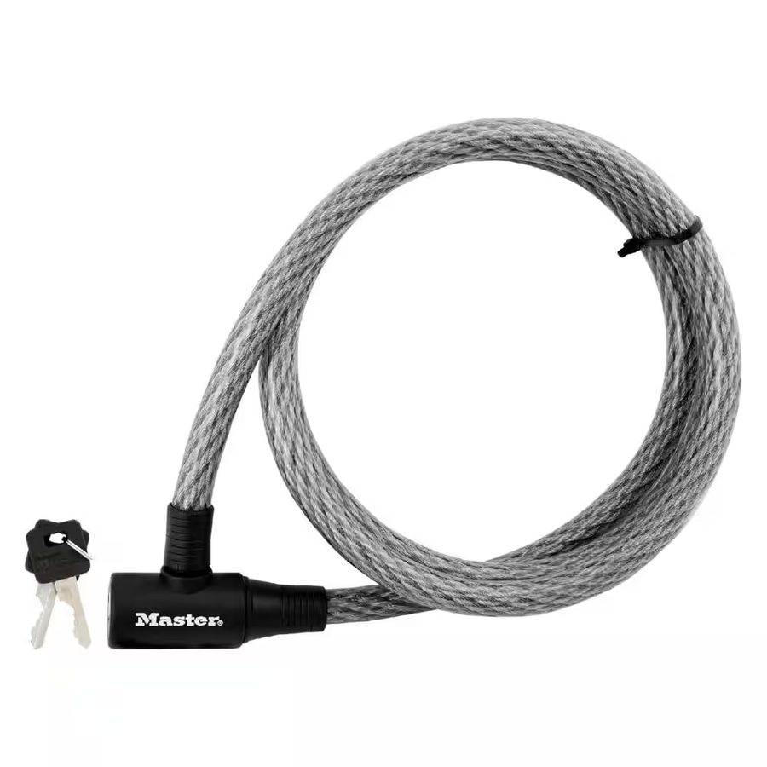
Locks
CABLE LOCKS
Physical locks have been used for hundreds of years; their design has not changed much: a metal “token” is used to align pins in a mechanical device. Physical locks have survived for years because they are low cost. Because all mechanical devices have tolerances, it is possible to sneak through these tolerances by “picking” the lock.

Slide 20
USB
Data Blocker
The USB connection has four conductors: two for power and two for data. If you block the data conductors, you can still charge your device from a USB source without giving that device any access to the data. When charging your phone in locations such as airports, or other unknown power sources, the use of a USB data blocker protects the phone but allows it to charge.

Slide 21
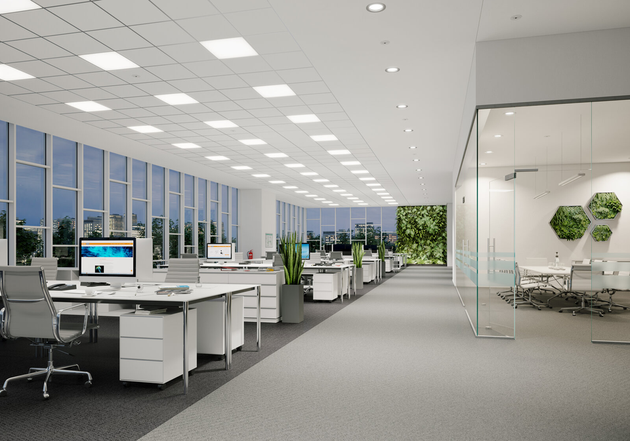
Ligthing
Proper lighting is essential for physical security. Unlit or dimly lit areas allow intruders to lurk and conduct unauthorized activities without a significant risk of observation by guards or other personnel. External building lighting is important to ensure that unauthorized activities cannot occur without being observed and responded to. Internal lighting is equally important because it enables more people to observe activities and see conditions that are not correct.

Slide 22
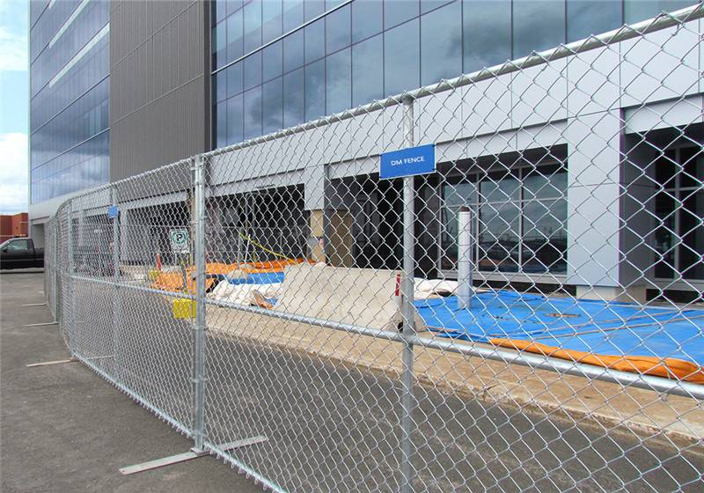
Fencing
Fencing serves as a physical barrier around property. It can serve to keep people out or in, preventing the free movement across unauthorized areas. Fencing can be an important part of a physical security plan. Properly employed, it can help secure areas from unauthorized visitors. Outside of the building’s walls, many organizations prefer to have a perimeter fence as a physical first layer of defense.

Slide 23
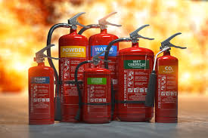
Fire Suppression
Fire suppression systems are designed to provide protection against the damage from a fire that spreads in a facility. Because they are suppression systems, they don’t prevent the fire from occurring per se, but they do stop it once it begins.
Water-Based Fire Suppression Systems
Clean-Agent Fire Suppression Systems
Handheld Fire Extinguishers
Fire Detection Devices

Slide 24
Sensors
MOTION DETECTION
When monitoring an area for unauthorized activity, one potentially useful tool is a motion detector. In areas where there is little or no expected traffic, a motion detector can alert an operator to activity in an area. Motion detectors come in a variety of types, but most are based on infrared (heat) radiation and can detect the changes of a warm body moving. They can be tuned for size, ignoring smaller movement such as small animals in outdoor settings.

Slide 25
Sensors
NOISE DETECTION
Noise detection is a sensor method that listens for specific sounds. Ordinary things can produce different sounds, and each of these can have a specific spectral signature that can be used to hear some items while ignoring others. Glass breakage has a specific sound, and sensors can be tuned to “hear” glass breakage and provide an alert when it occurs. The use of sensors that target events such as this and provide the information to a central alarm panel can greatly increase the effectiveness of security personnel in monitoring a larger facility.

Slide 26
Sensors
PROXIMITY READER
Proximity readers are sensors that provide a signal at a specified distance. The most common application of these are card readers connected to doors: you “swipe” your card by placing it near the reader, and if the codes are correct, you are granted access. However, these devices have much greater utility. A series of proximity readers scattered throughout a facility can act as a reporting sensor, monitoring guards as they traverse their appointed rounds.

Slide 27
Sensors
MOISTURE DETECTION
Moisture, or water, can have significant detrimental effects on certain items. Moisture detection sensors provide a remote means of monitoring everything from water leaks to humidity problems. Water can cause damage to electronics, artwork, and many other items. Being able to monitor moisture levels provides the security team a means of detecting the potential for damage from items such as leaking sprinklers or water leaks

Slide 28
Sensors
CARDS
Controlling physical access to a small facility can be achieved through door locks and physical keys, but that solution is unwieldy for larger facilities with numerous people coming and going. Many organizations rely on a badging system using either tokens or cards that can be tied to automated ID checks and logging of entry/exit. This can provide much greater detail in tracking who is in a facility and when they have come and gone. Tokens and cards can provide a serialized ID for each user, enabling user-specific logging.

Slide 29
Sensors
TEMPERATURE
Temperature sensors do exactly what you’d think: they sense temperatures. Part of the physical security equation is preventing damage to the infrastructure in an organization, and servers can be an important part of that infrastructure. Server rooms are highly temperature-controlled areas, with hot and cold sides, as servers tend to generate heat, and that heat needs to be removed.

Slide 30
Drones
The use of drones has risen sharply in the past couple of years. From home/hobbyist models that can carry a small camera, to larger industrial rigs that can carry larger cameras for longer periods, these devices have revolutionized remote viewing of items. Drones are used by railroads to inspect tracks and used by electric companies to inspect power lines.

Slide 31
Visitor Logs
Physical security visitor logs provide the same utility as computer logs for a security investigation. They act as a record of what was observed at specific points in time. Having roving guards check in at various places across a shift via a log entry provides a record of the actual surveillance. Logs of visitors arriving and departing, equipment received and shipped out, and so forth serve as a record of the physical happenings in a facility.

Slide 32
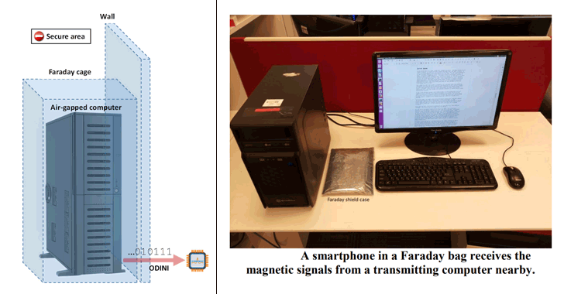
Faraday Cage
An example of shielding that can be employed is a Faraday cage or Faraday shield, which is an enclosure of conductive material that is grounded. This can be room-sized or built into a building’s construction; the critical element is that there is no significant gap in the enclosure material.

Slide 33
Air Gap
Air gap is a term used to describe the physical and logical separation of a network from all other networks. This separation is designed to prevent unauthorized data transfers to and from the network. The flaw in this logic is that users will move data by other means, such as a USB drive, to get their work done.

Slide 34
Screened Subnet
The concept of a screened subnet (previously known as a demilitarized zone [DMZ]) comes from military parlance where it represents an area that is not “owned” by either side. This concept is used in networking to indicate a zone where access controls are not as strict as the inside, or as open as the outside; it’s a place of joint cooperation and controlled risk.

Slide 35
Protected Cable Distribution
Cable runs between systems need to be protected from physical damage to the cables and subsequent communication failures. This is accomplished by protected distribution/protected cabling during the cable installation. This may be something as simple as metal tubes or as complex a concrete pipes to run buried cables. The objective is to prevent any physical damage to the physical layer portion of the system.

Slide 36
Secure
Areas
Secure areas are those areas where specific preventative measures are taken to control access both to and from. Like many other physical security constructs, there is a wide range of levels for secure areas. From those created by a simple locked door, to those with special procedures and guards, secure areas can be tailored to the security needs of an enterprise.

Slide 37
Secure
Areas
AIR GAP
Air gap is used to refer to a system where there is no direct connection to outside systems. An air-gapped network does not have a connection to outside networks. An air gap for a network extends to all physical connections, wired and wireless, and exists to protect a computer or network from outside influences or to keep data from leaving the system.

Slide 38
Secure
Areas
VAULT
A vault is a secured area that is designed to provide a specific level of security for what is stored inside. This can be a physical space, with specific safeguards such as walls that cannot be penetrated and doors that can be secured. A vault is a larger item than most safes, typically room sized. For example, a bank vault is used to store large sums of money and other valuables.

Slide 39
Secure
Areas
SAFE
Safes are physical storage devices that are intended to impede unauthorized access to their protected contents. Safes come in a wide variety of shapes, sizes, and costs. The higher the level of protection from the physical environment, the better the level of protection against unauthorized access.

Slide 40
Secure
Areas
HOT AND COLD AISLE
The trend toward smaller, denser servers means more servers and devices per rack, putting a greater load on the cooling systems. This encourages the use of a hot aisle/cold aisle layout. A data center that is arranged into hot and cold aisles dictates that all the intake fans on all equipment face the cold aisle and that the exhaust fans all face the opposite aisle. The HVAC system is then designed to push cool air underneath the raised floor and up through perforated tiles on the cold aisle.

Slide 41
Secure
Data Destruction
BURNING
Burning is considered one of the gold-standard methods of data destruction. Once the storage media is rendered into a form that can be destroyed by fire, the chemical processes of fire are irreversible and render the data lost forever. The typical method is to shred the material, even plastic discs and hard drives (including SSDs), and then put the shred in an incinerator and oxidize the material back to base chemical forms. When the material is completely combusted, the information that was on it is gone.

Slide 42
Secure
Data Destruction
SHREDDING
Shredding is the physical destruction by tearing an item into many small pieces, which can then be mixed, making reassembly difficult if not impossible. Important papers should be shredded, and important in this case means anything that might be useful to a potential intruder or dumpster diver. It is amazing what intruders can do with what appears to be innocent pieces of information. Shredders come in all sizes, from little desktop models that can handle a few pages at a time, or a single CD/DVD, to industrial versions that can handle even phone books and multiple discs at the same time.

Slide 43
Secure
Data Destruction
PULPING
Pulping is a process by which paper fibers are suspended in a liquid and recombined into new paper. If you have data records on paper, and you shred the paper, the pulping process removes the ink by bleaching, and recombines all the shred into new paper, completely destroying the physical layout of the old paper.

Slide 44
Secure
Data Destruction
PULVERIZING
Pulverizing is a physical process of destruction using excessive physical force to break an item into unusable pieces. Pulverizers are used on items like hard disk drives, destroying the platters in a manner that they cannot be reconstructed. A more modern method of pulverizing the data itself is the use of encryption

Slide 45
Secure
Data Destruction
DEGAUSSING
A safer method for destroying files on magnetic storage devices (that is, magnetic tape and hard drives) is to destroy the data magnetically, using a strong magnetic field to degauss the media. Degaussing realigns the magnetic particles, removing the organized structure that represented the data. This effectively destroys all data on the media. Several commercial degaussers are available for this purpose

Slide 46
Secure
Data Destruction
PURGING
Data purging is a term that is commonly used to describe methods that permanently erase and remove data from a storage space. The key phrase is “remove data,” for unlike deletion, which just destroys the data, purging is designed to open up the storage space for reuse.

Slide 47
Thank
You

